Slide 1

Bank of America:
Global Banking,
Commercial Loan, & Leasing Technology
Division
Management Skills Group 1
Ava Wilmot, Ethan Wan, David Sobelman, Jay Atreya, & Yantao Li

Slide 2
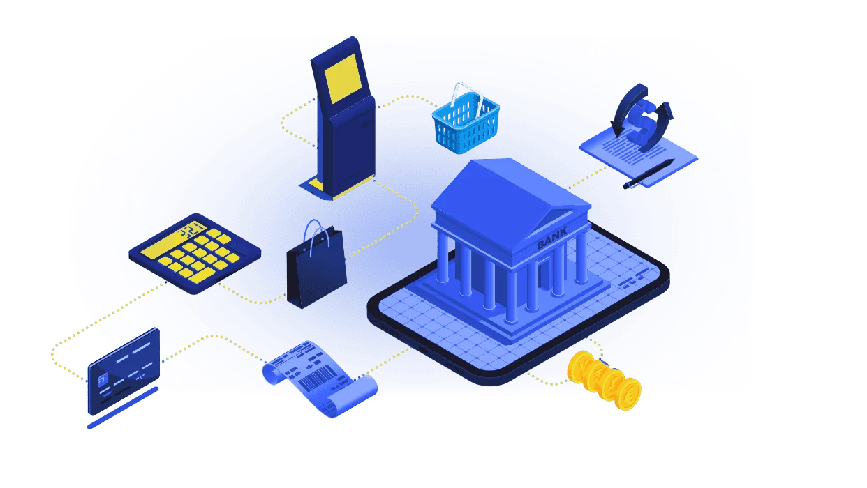
Company Access
We worked with Bank of America’s Global Banking, Commercial Loan, & Leasing Technology Division based out of Pennington, New Jersey this semester
Our team’s primary contact was Senior VP/Project Manager Gregg Wilmot
  gregg.wilmot@boa.com/(609) 274-3294
Our team’s secondary contact was VP/Programmer Analyst Paul Lane

Slide 3
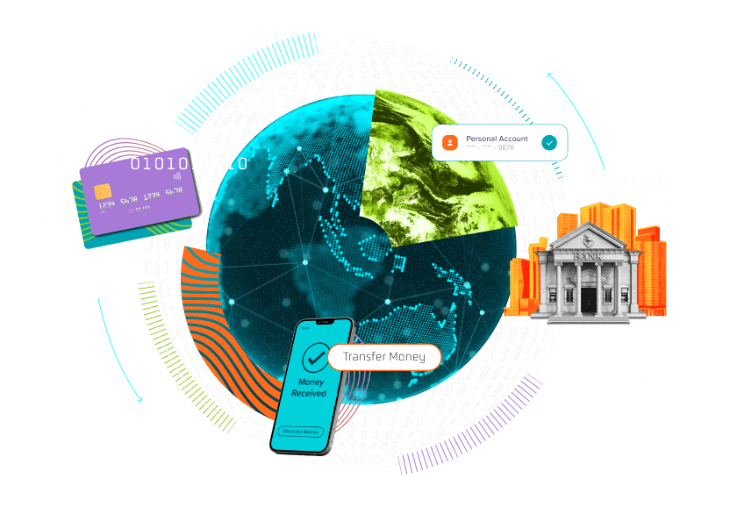



Background Information &
Secondary Data Research
The Global Banking, Commercial Loan & Leasing Technology Divisionis a cross-functional team
  Consists of engineers, analysts, IT PMs, cybersecurity, etc.
  Their main strategy is to maintain secure lending systems while modernizing technology
Industry Context
  Part of the “Big 4” U.S. banks, with their main competitors being JPMorgan Chase, Wells Fargo, Citigroup
  Finance/banking industry is shifting toward AI, cloud computing, and digital banking
  Legacy systems still critical to operations
Key Trends/Data
  High digital engagement (billions of logins, transactions, AI interactions)
  AI driving productivity and operational efficiency
  Hiring slowdowns & economic pressure on smaller firms
Secondary Data Research
  Microsoft: strong onboarding, mentorship improves integration of new engineers
  ING: “squad/tribe” agile teams increase collaboration during tech transitions
  Ford: failure to properly manage digital transformation creates major operational risk

Slide 4

Data Collection
Methods & Timeline
Data Collection Methods:
  Primary: manager interviews (qualitative insights)
  Secondary: case studies + industry research
  Team collaboration: question prep, discussion, and analysis
Timelines
  2/21: Initial interview (Gregg Wilmot) → defined problem & context
  2/22-2/28: Secondary research → industry trends, legacy systems, onboarding
  3/1: Follow-up interview (Gregg Wilmot & Paul Lane) → staffing, training, migration challenges
  Post 3/1:
    Synthesized primary & secondary data
    Identified key themes: staffing gaps, knowledge transfer risk, transition timeline
    Connected findings to course concepts (team effectiveness, organizational justice)
    Refined problem statement and validated insights

Slide 5

Output Problem &
Manager/Employee Perspective
Core Issue
  30-year-old legacy platform is maintained by 7 specialists (avg. age ~60)
  Imminent retirements → 4-5 year knowledge transfer gap
Gregg Wilmot (Manager Perspective)
  Concerned about losing SMEs before transition is complete
  Limited resources to both maintain system and modernize
  Identifies time constraint & staffing shortage as biggest barriers
  Responsible for ensuring system stability during transition
Paul Lane (Employee Perspective)
  Notes his legacy expertise is short-term valuable but long-term uncertain
  Concerned about balancing learning new system while supporting old one
  Views transition process as unclear and potentially unfair
  Feels pressure from workload and shifting skill demands
Overall Challenge
  Maintain operations, transfer knowledge, and modernize system simultaneously
  High risk of disruption if transition is not completed before retirements

Slide 6

Course Concept 1:
Team Effectiveness Model
Is a team effective?
  Context: General background information
  Team Composition: Constructing/deconstructing team for project
  Work Design: Analyze task in relation to team.
  Process: How the team will complete the task.

Slide 7


Output Problem & Team
Effectiveness Model
Context:
  30 year old system -> New software
  Lack of resource and support for team
  Strict Deadline
Team Composition
  Lack of diversity
  Small team of SMEs
    ING & Microsoft
  Onboarding is a necessity

Slide 8

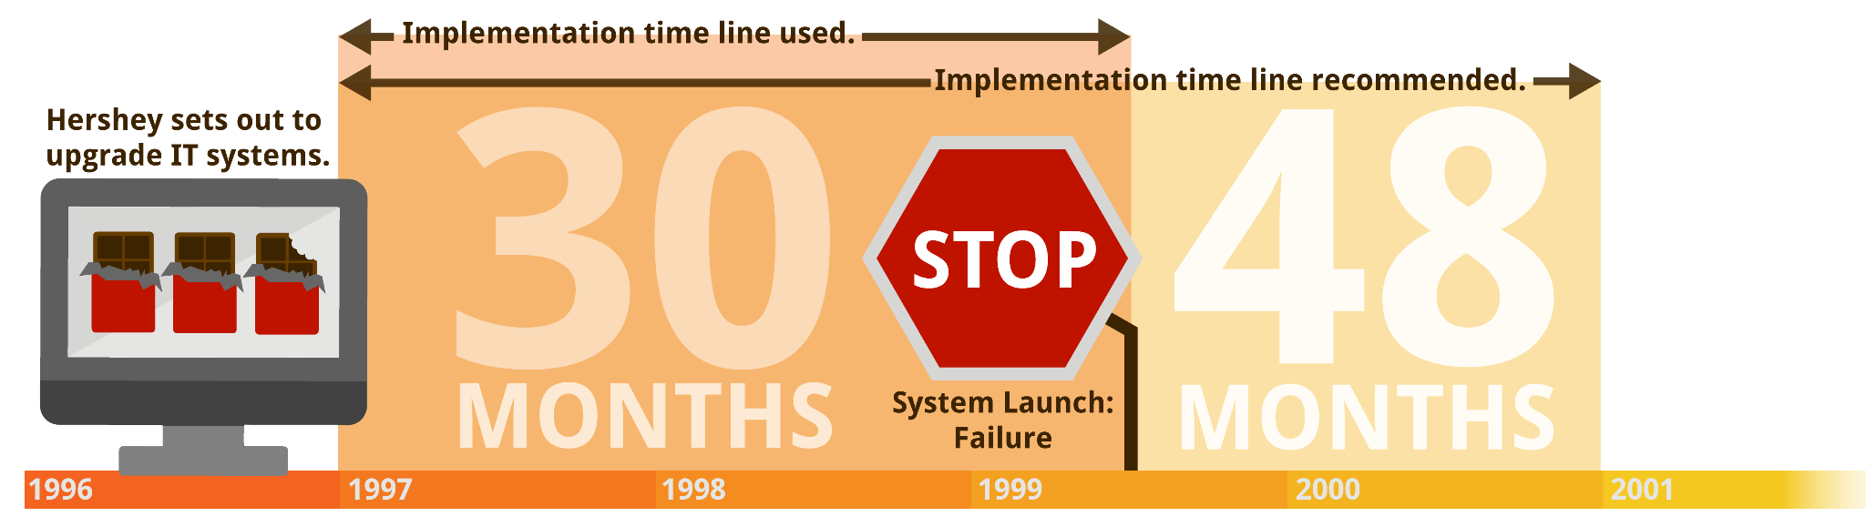
Output Problem & Team
Effectiveness Model (continued)
Work Design:
  Split focus within the project
    Complications for managers
    Tony Lane: employees work design simple
  Deadline presents potential conflicts
    Hershey and GE
Process
  Current path is still unclear
  Take research into account
    No shortcuts

Slide 9
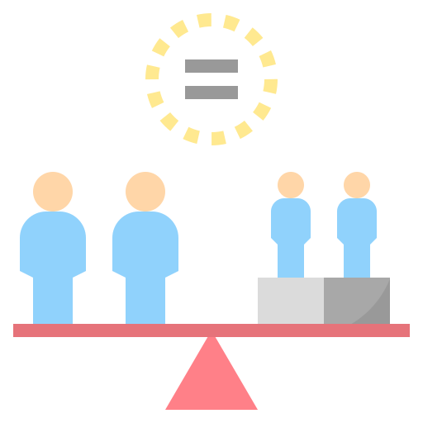
Course Concept 2:
Organizational Justice
Understanding Organizational Justice
Organizational justice refers to how fair employees believe the organization is
Distributive Justice focuses on fair workload, rewards, and responsibilities
Procedural Justice focuses on fair and transparent decision making
Interactional Justice focuses on respectful treatment and clear communication.
When employees feel fairness, trust and motivation usually increase. This concept is important during changes/system transitions and helps explain the employee side of organizational change.

Slide 10

Output Problem & Organizational
Justice (continued)
Small expert team: Only seven employees are responsible for maintaining the critical legacy system.
Heavy workload pressure: Because the team is so small, responsibilities and daily pressure are placed on a limited number of specialists.
Retirement risk: As experienced employees retire, the remaining staff may face even greater pressure and knowledge loss.
Unclear transition process: Employees may feel uncertain if the roadmap to the new system is not clearly explained.
Limited employee input: If workers are not involved in planning decisions, they may question leadership choices.
Impact on fairness: These issues can lower morale, increase stress, and reduce confidence during the transition.

Slide 11

Output Problem & Organizational
Justice (continued)
Communication matters: Clear communication is important during a major system transition.
Regular updates: Frequent updates can reduce uncertainty and help employees understand what comes next.
Value current experts: Employees with knowledge of the old system should feel respected and included in the transition process.
Transparent leadership: Honest leadership can build trust and reduce resistance to change.
Positive team impact: When employees feel supported, morale and teamwork are usually stronger.
Better results: Fair treatment and strong communication can help Bank of America complete a smoother modernization process.

Slide 12
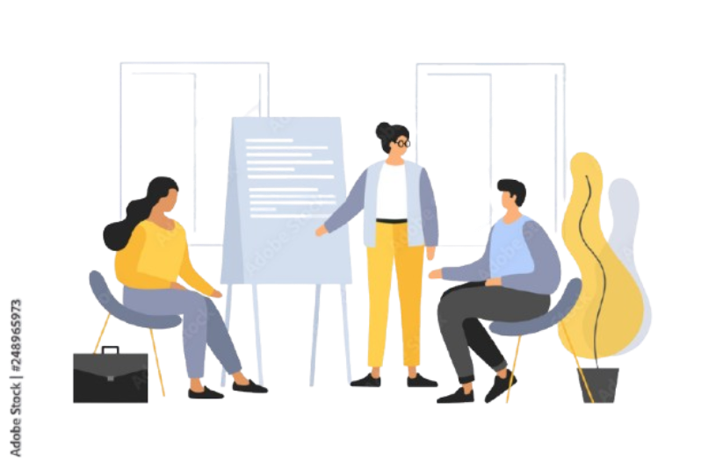
Description & Details
of First Recommendation
Hire and train new employees on the legacy system to prepare for retiring experts and knowledge loss
Ensures new employees fully understand the legacy system to maintain operations, hold the company afloat, and prevent system failure during the transition
Addresses Team Effectiveness Model weaknesses:
  Context: understaffed team
  Team Composition: limited legacy system expertise
  Work Design: small team with high responsibility, causes increased pressure
  Process: no clearly defined transition plan
Supports a smoother migration by maintaining stability while transitioning to a new system

Slide 13
Best Practices and Potential Downsides of First Recommendation
Best Practices
ING
  Cross-functional teams, which improved collaboration and flexibility
Microsoft
  Clear guidance from management
  More effective in adapting to work environment
Potential Downsides
May not work effectively:
  Legacy system is outdated and highly specialized so it’s difficult for new hires to learn quickly
  Training process may take too long to have immediate impact
Costs:
  Hiring and training expenses (recruitment, training programs, time investment)
  Existing employees must spend time training and they might demand additional pay
Potential unintended consequences:
  Increased pressure on current team during training period
  Risk of burnout, dissatisfaction, or quitting

Slide 14
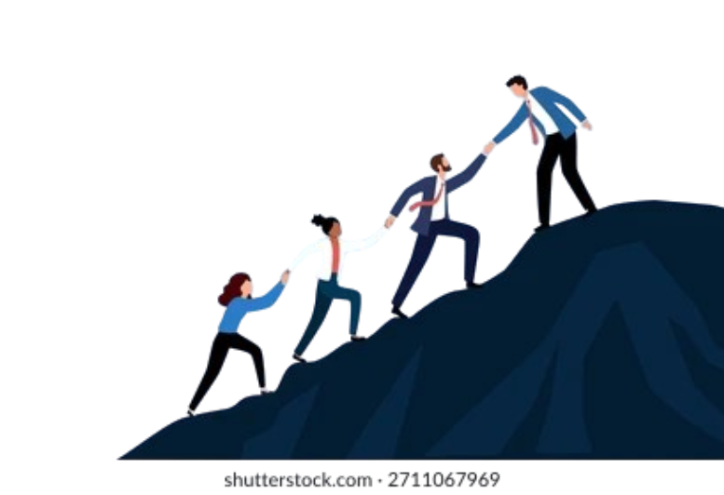
Description & Details of Second Recommendation
Address fairness concerns using Organizational Justice to prevent frustration, low engagement, and resistance during the transition
Distributive Justice:
  Bring in temporary support from other departments to handle less specialized tasks
  Reduces pressure on the small legacy team, which is currently carrying an unfairly heavy workload due to limited staffing and expertise
Procedural Justice:
  Involve legacy system employees in transition and training decisions
  Increases transparency and reduces confusion from the lack of a structured plan
Interactional Justice:
  Improve communication through consistent updates and clear expectations
  Ensures employees feel informed, valued, and included
Promotes fairness in workload, decision-making, and communication
Reduces resistance and supports a smoother system transition

Slide 15
Best Practices & Potential Downsides
of Second Recommendation
Best Practices
Clear Communication Channels, two-way feedback, regular updates
  Understand purpose of any systematic, leadership, or other changes
Impact for Bank of America
  Make system transition smoother
  Increased willingness to support changes
Potential Downsides
May not work effectively:
  Temporary support employees may lack specialized knowledge
  Limited ability to reduce workload on legacy system experts
Costs:
  Increased labor costs from allocating or adding employees
  Reduced productivity in other departments providing support
Potential unintended consequences:
  Involving more employees in decisions may slow down the transition
  Risk of disagreements or delays in decision-making

Slide 16

Communication Strategies &
Influencing Tactics
Rational Persuasion
  Recommendations are supported by research
  Directly address risks that are currently not accounted for
Consultation
  Involve current employees in planning process
    Design a system that they can commit to
This creates an effective system that is designed and implemented by employees.

Slide 17
Thank you!

